Slide 1


COUPON
COLLECTOR
-Android App-

Slide 2
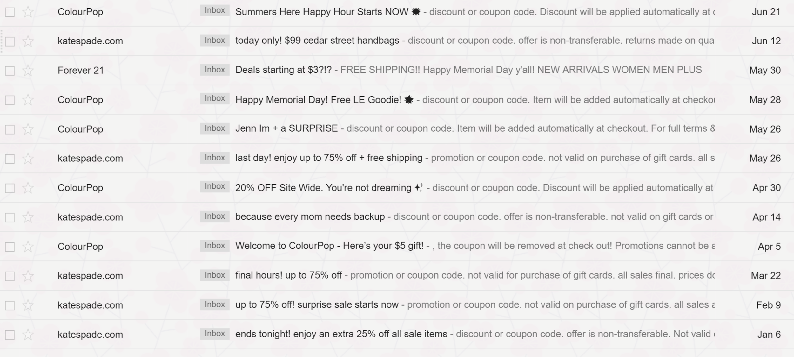
Problem
Can’t keep track?

Slide 3
Our Solution
Electronically store ‘em!

Slide 4
Here’s how the app works!
1
2
3
TARGETS BUSY PEOPLE
USERS SELECT A CATEGORY
STORES COUPONS IN USER FRIENDLY APP
Users can easily log in, use guest login, or register
Various categories include food, clothing, travel, and electronics
Can organize by category, store, or price

Slide 5
Future Enhancements
FILTER OPTIONS
INCENTIVES
YELP
LOCATION: incorporate a map to locate nearby stores
SAVINGS: Filter by percent off or dollars saved
EXPIRATION DATE
Point and benefit systems for users who upload coupons
Link the locations and restaurants with its respective Yelp review
CALCULATIONS
COLLEGE STUDENT EDITIONS
STACKING
Calculate the amount of savings given the price of a certain item and a corresponding coupon
Automatically combine all valid coupons for the best possible price
Select to nearby stores for college student use

Slide 6


What makes us different?
The Details
ORGANIZE BY STORE
COMPILES ALL COUPONS INTO A SINGLE APP

Slide 7

Thank You
For Your Attention
Notes:
https://pixabay.com/en/typewriter-book-notebook-paper-801921/

